Slide 1


Stray Light Correction Matrix
Muneeb Ali
Supervision :Jan Audenaert
Leadership :Frédéric Leloup

Slide 2
Main source of Inspiration
“Simple spectral stray light correction method for array spectroradiometers”
Yuqin Zong, Steven W. Brown, B. Carol Johnson, Keith R. Lykke, and Yoshi Ohno
(https://journals.ametsoc.org/view/journals/atot/26/1/2008jtecho597_1.xml)

Slide 3
Overall workflow
Setting Up environment
Data acquisition
Readout Noise
Dark Noise
Light measurement
Data Analysis
Line Spread Function (LSF)
Stray Light Signal Distribution Function (SDF)
Conditional number
Validation(….Ongoing )

Slide 4
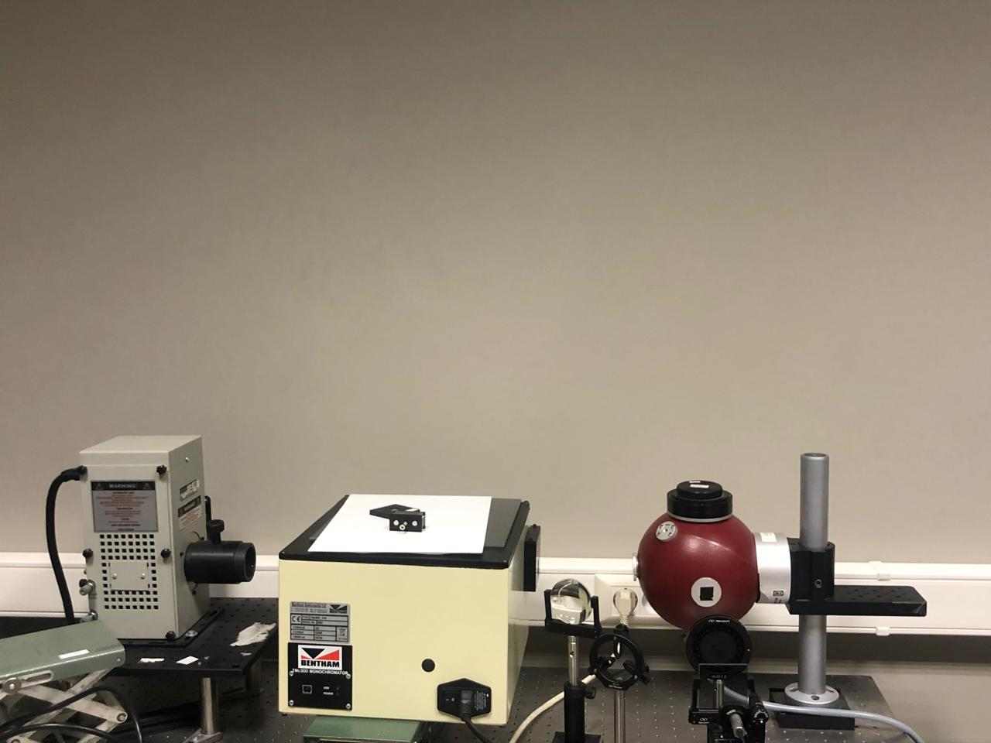
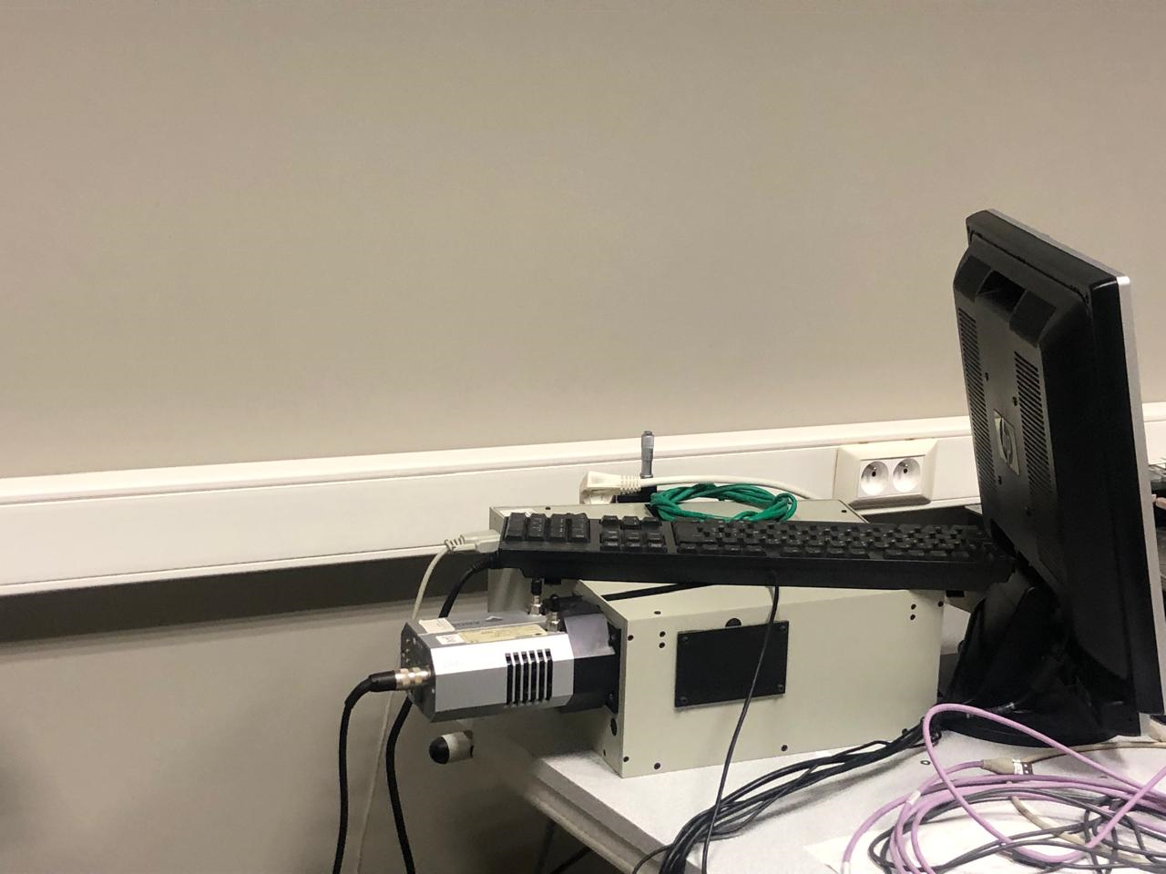
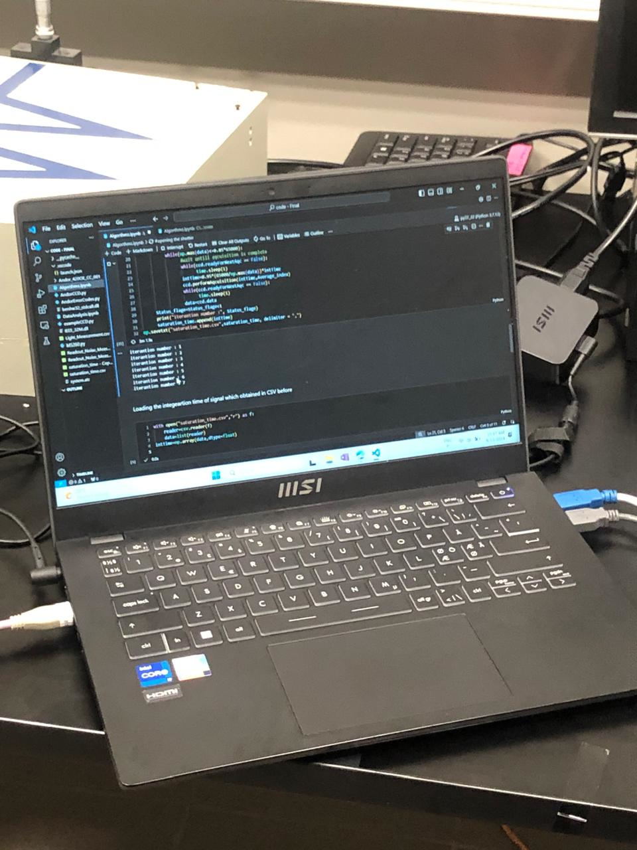
Setting Up environment (Physical)
Setup

Slide 5
Setting Up environment (Software playground )
32 bits environnent in anaconda with python 3.7
Scripts, DLLs, configuration files
MS260 spectrograph with COM port
(Used del connection or restart python environment if error appear related to connection ,which shows connection is already established and we don’t need to send connection signal again)
Set the desired temperature, and ensure the AndorCCD library is there
Use ctypes to load and interact with the monochromator’s DLL (benhw32_stdcall.dll), ensuring proper initialization and error handling.
Confirm that the Andor driver is installed on the local machine !!!!!
(Andor Driver Pack - 2.104.30065.0 (CCD,ICCD & EMCCD) - Andor Learning Centre- Oxford Instruments (oxinst.com)
Set the desire value for wavelength range and require steps
(Further used configuration can be found in code )

Slide 6
Readout Noise
Close Shutter: Prevent light exposure by closing the spectrograph shutter.
Measure Readout Noise: Perform multiple acquisitions across a range of integration times, capturing noise data.
Store Data: Append the acquired data to a 2D matrix for each acquisition.
Monitor and Save: Track progress and save the complete noise data to a CSV file.
Calculate Intercepts: Compute the intercept at each pixel from the readout noise data.
Set the averaging index to a value like 10 to minimize fluctuations. Non-stable values can lead to negative intercepts in some pixels.

Slide 7
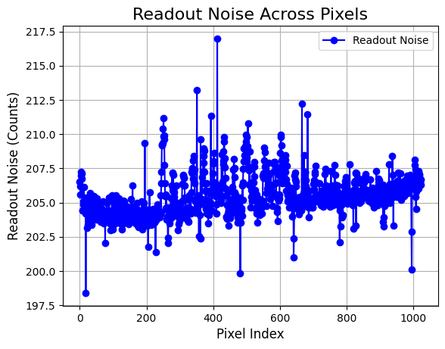

Slide 8
Saturation Time
(Need to used saturation time of max value otherwise correction matrix will be time dependent )
Shutter Control: The shutter is opened using `spectr.command('shutter o')` to start light exposure for data acquisition.
Wavelength Selection: The wavelength is adjusted for each iteration using mono.BI_select_wavelength.
Integration Time Adjustment: The integration time (`intTime`) is dynamically adjusted to avoid saturation, aiming to keep pixel values below 85% of the maximum (65,000).
(Use the linear relationship between exposure time and charge count to directly calculate the required time for a target charge level (e.g., 85%, 90%, or 95%) instead of increasing time step by step)
Data Acquisition: The CCD captures images at each wavelength, adjusting exposure time to optimize signal levels.

Slide 9
Light measurement and Dark Noise 1/3
Wavelength Step: Specify wavelength range, with measurements taken at regular intervals defined by `step_wavelength.
Choosing smaller wavelength steps can significantly increase the computational complexity of the algorithm. It is more efficient to select larger steps (e.g., 10, 8, or 5 nm). Later, linear interpolation can be used to achieve more accurate results with less computational effort.)
Light and Dark Noise Acquisition: For each wavelength, the shutter is opened to acquire light measurements and closed to acquire Dark noise measurements, both using a specific integration time.
Data Collection: Light and Dark noise data are stored in separate 2D matrices for each wavelength step

Slide 10
Light measurement and Dark Noise 2/3
(For every wavelength and need to use saturation time for calculating Dark and light measurement )
(Some fluctuation has been seen when Dark and light measurement have been taken separately , batter measure in same iteration , see the code)
The monochromator requires time to adjust to the selected wavelength, necessitating a delay between setting the wavelength and performing light measurements.
(I manually measured this delay using a stopwatch, finding it to be approximately 12±2 seconds. To ensure accuracy, I set a 20-second sleep time. While this can be shortened to improve algorithm efficiency, it's safer to maintain a longer delay.)

Slide 11
Light measurement and Dark Noise 1/3
Selecting the appropriate wavelength range is crucial.
It's essential to consider the spectrum of the broadband source—if the source doesn't emit wavelengths above 240 nm or 200 nm, including those ranges is unnecessary.
I chose a wavelength range of 250 nm to 900 nm, considering the long tail in the infrared region. This broader range will also allow for a larger n-by-n matrix, which can be beneficial for subsequent analysis.

Slide 12
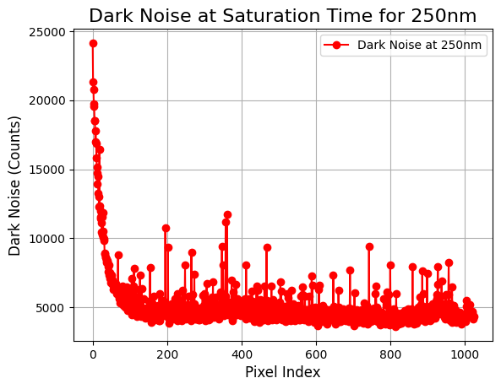
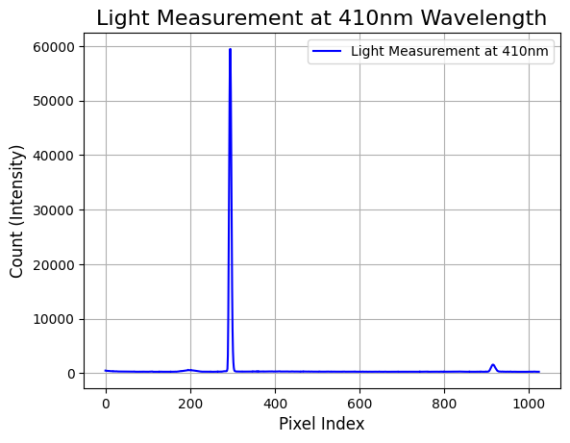
Sample acquisition

Slide 13
Data Analysis: Line Spread Function (LSF)
LSF = np.zeros((972, 972)) creates a 972x972 matrix for Line Spread Function (LSF).
(Initializing an empty matrix can lead to inaccurate results since each pixel's value is critical and may require interpolation. Starting with an empty matrix can cause issues with data stacking, especially the matrix begins filling from the 0th index. It's better to initialize the matrix with 0 or another placeholder that clearly indicates uninitialized values, ensuring that the interpolation process is accurate, and that no pixel data is accidentally overridden or misplaced.
Calculated LSF using formula listed in code block.
Need to make zero the negative values (Clipping)
(https://www.imatest.com/docs/stray-light-flare/calculations/)

Slide 14
Stray Light Signal Distribution Function (SDF) 1/2
Perform interpolation to fill the missing values
Starting from 250nm has already reduced the matrix size from the ideal 1024 by 1024, making extrapolation unnecessary.
While non-linear interpolation methods are an option, linear interpolation has proven sufficient for our needs. Further attempts with reduced measurement step sizes did not show significant improvements. Therefore, linear interpolation is enough .

Slide 15
Stray Light Signal Distribution Function (SDF) 2/2
The threshold must be set as a percentage of the maximum value, determining the range of values that should be zeroed out.
(Feinholz, M. E., S. J. Flora, M. A. Yarbrough, K. R. Lykke, S. W. Brown, B. C. Johnson, and D. K. Clark, 2009: Stray Light Correction of the Marine Optical System. J. Atmos. Oceanic Technol., 26, 57–73, https://doi.org/10.1175/2008JTECHO597.1.)
This research paper describe that the 0.2 % of maximum value is required to distinguish between inbound and out bound region .
Higher value can lead to the unstable correction matrix .
Calculated the correction matrix using formula in the original paper.

Slide 16
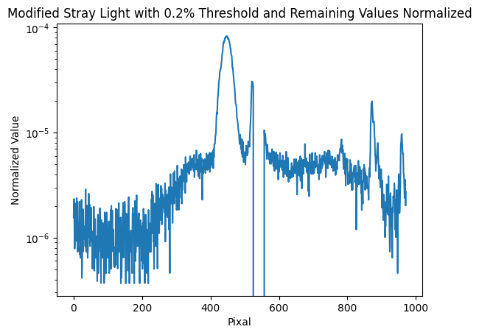

Slide 17
Signal contents
Raw Light Signal-----------------(Monochromatic Light +Dark noise +Readout noise +Stray Light+???)
Line Spread Function (LSF) -----------------(Monochromatic Light +Stray Light)
Stray Light Signal Distribution Function (SDF) -----------------(Stray Light)

Slide 18
Condition number
Inverse the relationship has been seen In Bound region width and condition number.
(Using a smaller inbound region can include more stray light in the correction matrix, which may cause the condition number to deviate from the ideal value of 1)

Slide 19
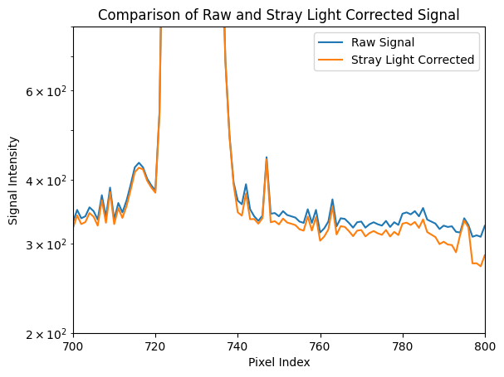
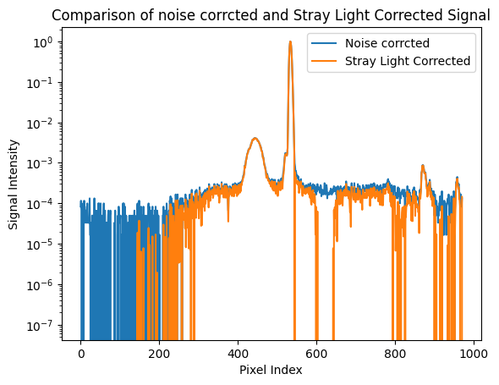
Validation(….Ongoing )
Still need time here !!!!!
If ideal case is to achieve Condition number
One then it means its Identity matrix and
anything multiplied by will give the same
Result ??????
IA=A
Does the role of correction matrix is to reduce the magnitude of un-expected signals ??????
Which signal to compare raw, or noise corrected ???
Comparing with Mono-chromatic response is idea ????
Notes:
Correction of Stray Light In Spectroradiometers and Imaging Instruments | NIST

Slide 20
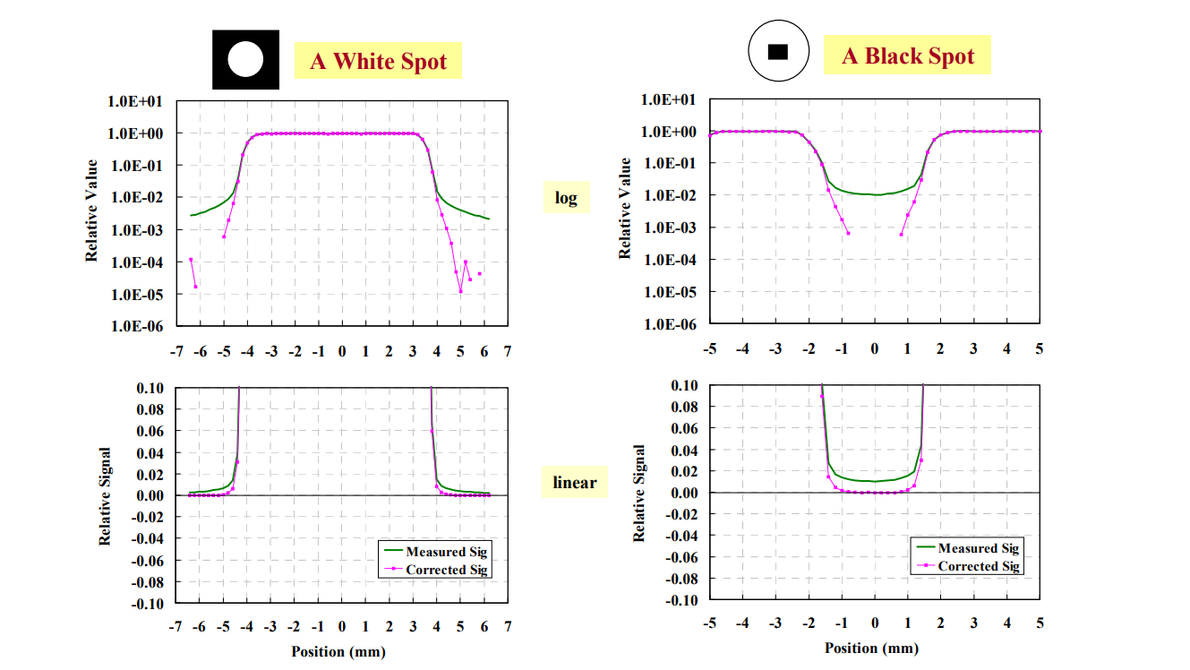
Validation(….Ongoing)
What does the rule of validation is , does it just minimize the few order of magnitude around peak .???
Should be stick to visible range only ????
Light source and its intensity ????( Lecture notes)
Spectral dependency, blue light spectral ????( Lecture notes)
Twice normalized ???
Notes:
https://tsapps.nist.gov/publication/get_pdf.cfm?pub_id=841127
Stray light correction on array spectroradiometers for optical radiation risk assessment in the workplace (hal.science)

Slide 21
Thanks for your attention

